Slide 2
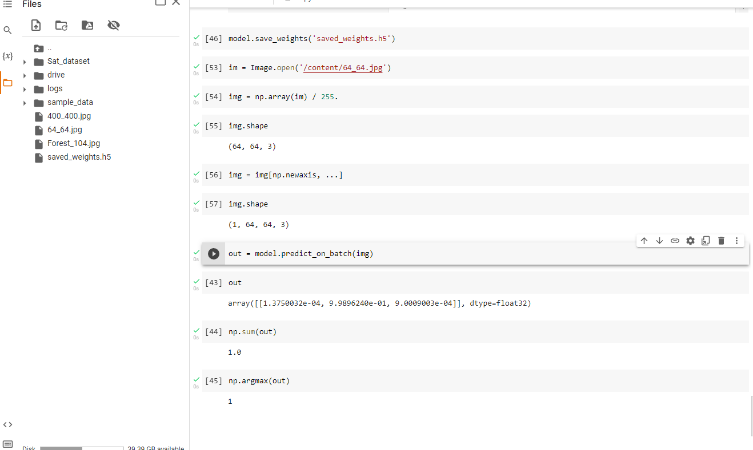

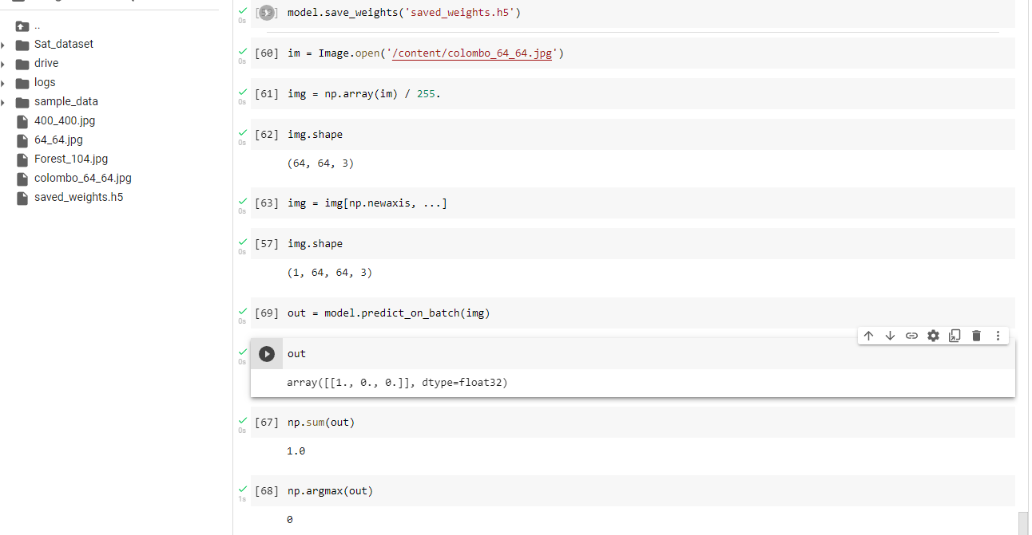

Google earth zoom level---1km-0.5km

Slide 3
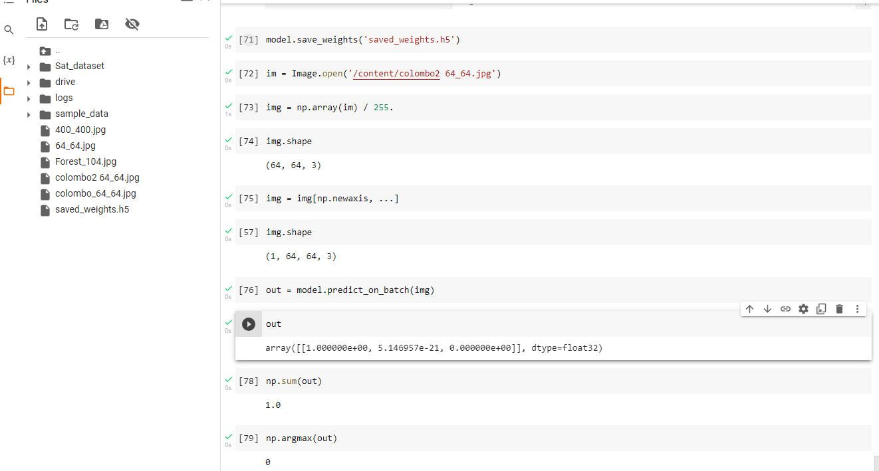

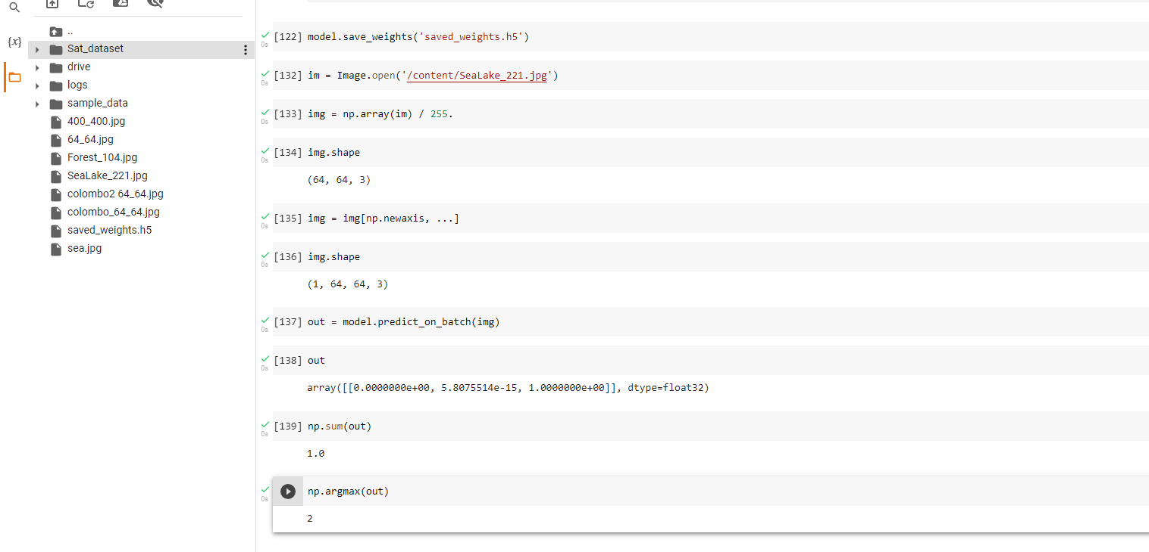


Slide 4
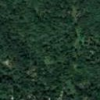
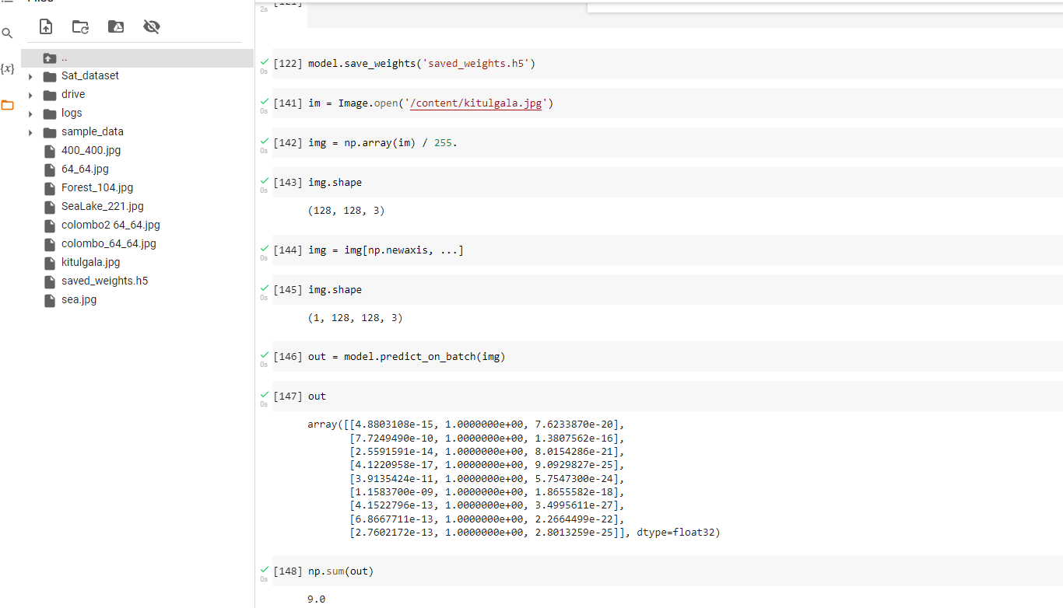
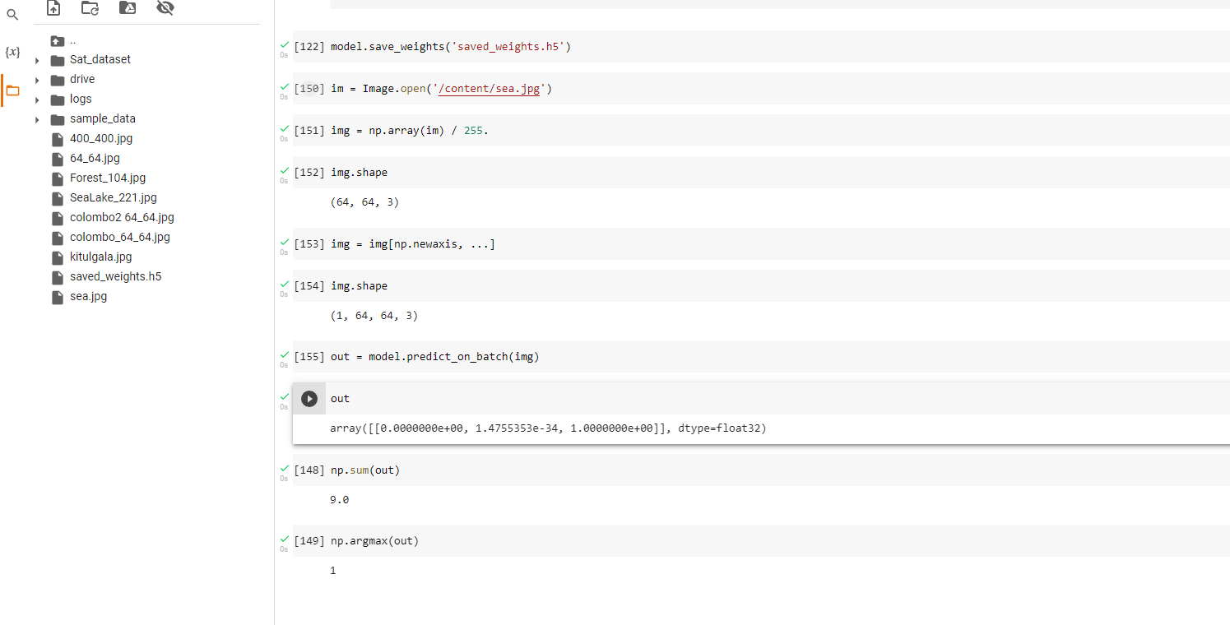

Kithulgala 1km
64*64
Colombo sea 1km
64*64

Slide 5
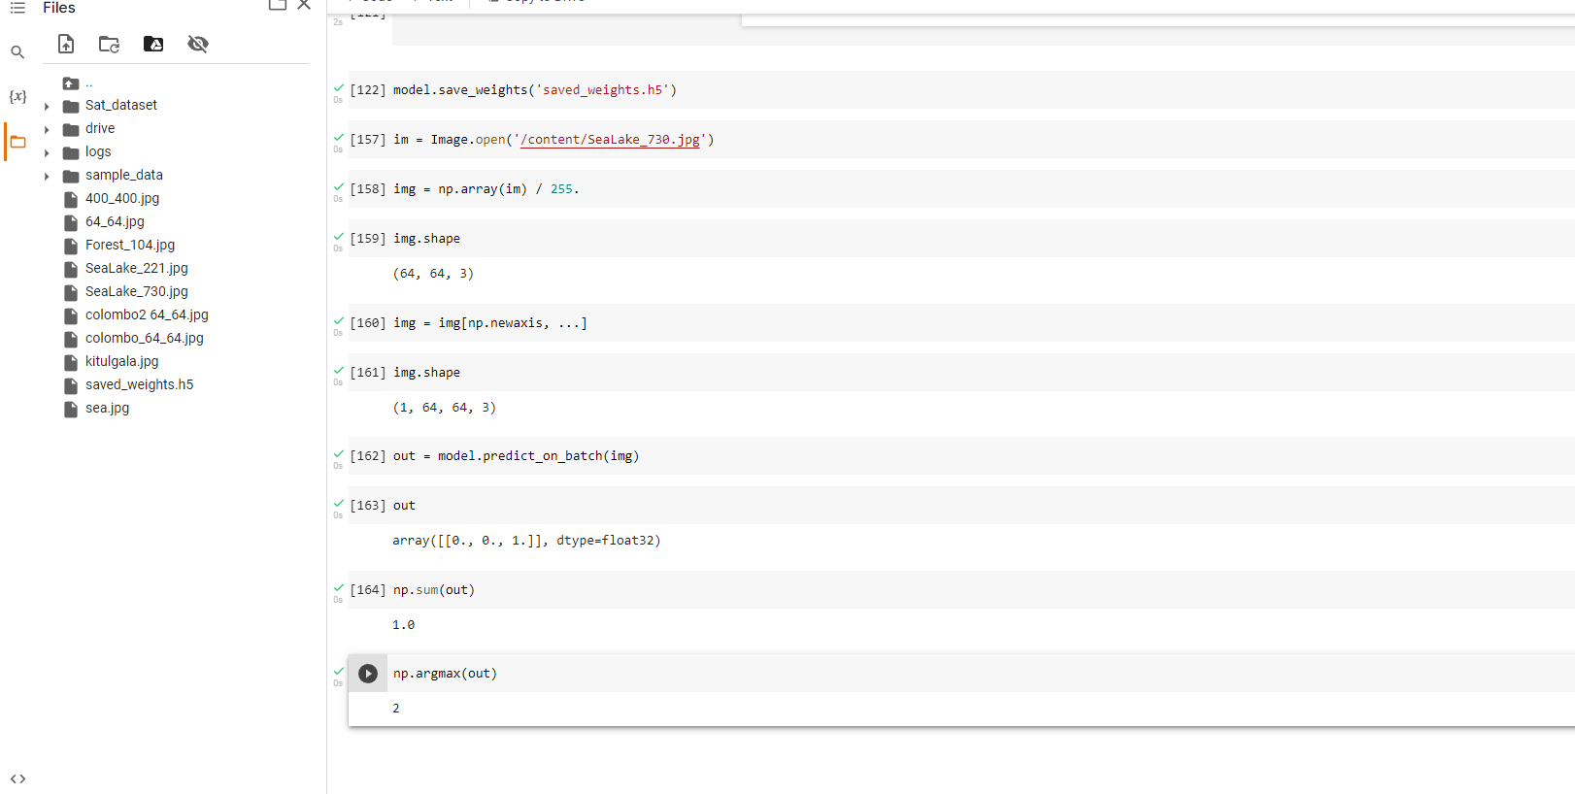

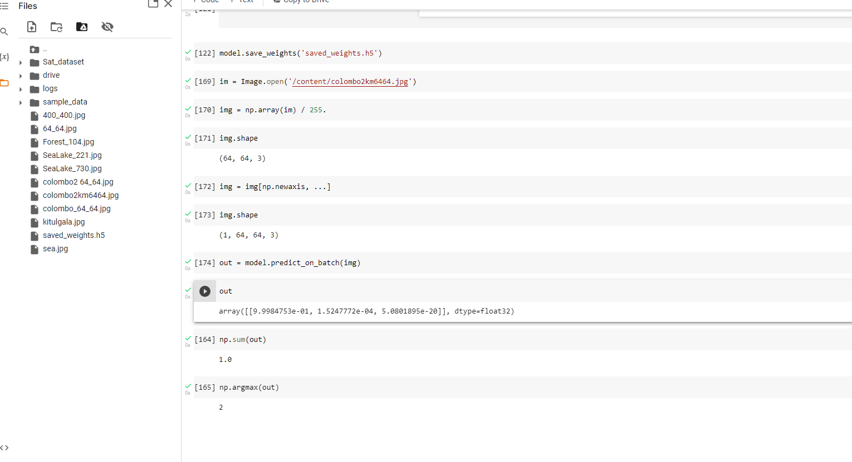

sample
Colombo 2km
64*64

Slide 6
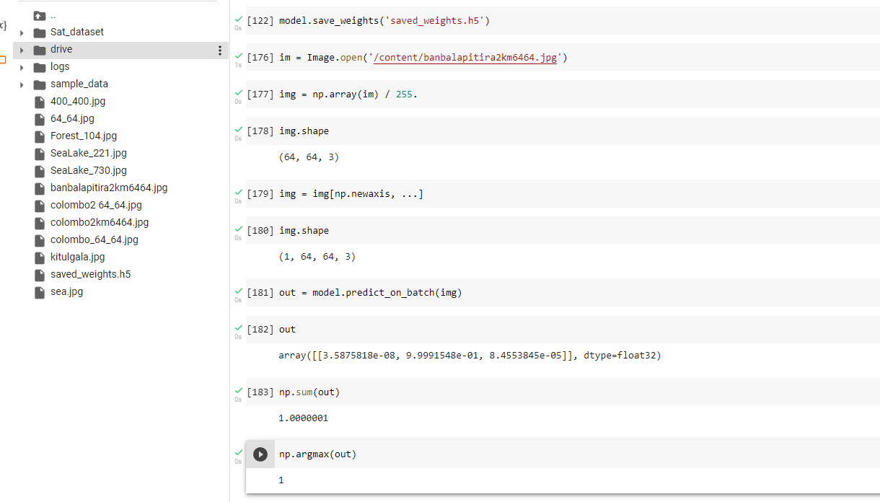

Bambalapitiyasea 2m
64*64

Slide 7

High resolution 8192*4925
Not good only contain one house

Slide 8
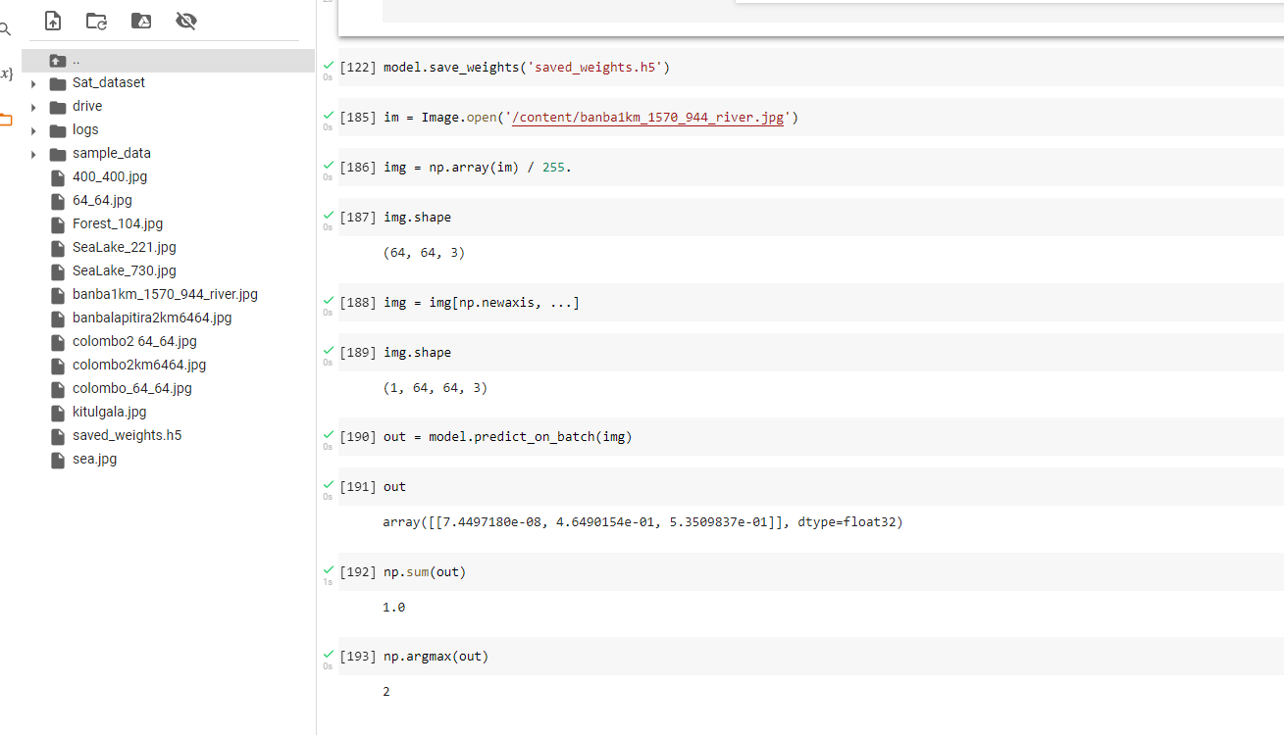


Slide 9
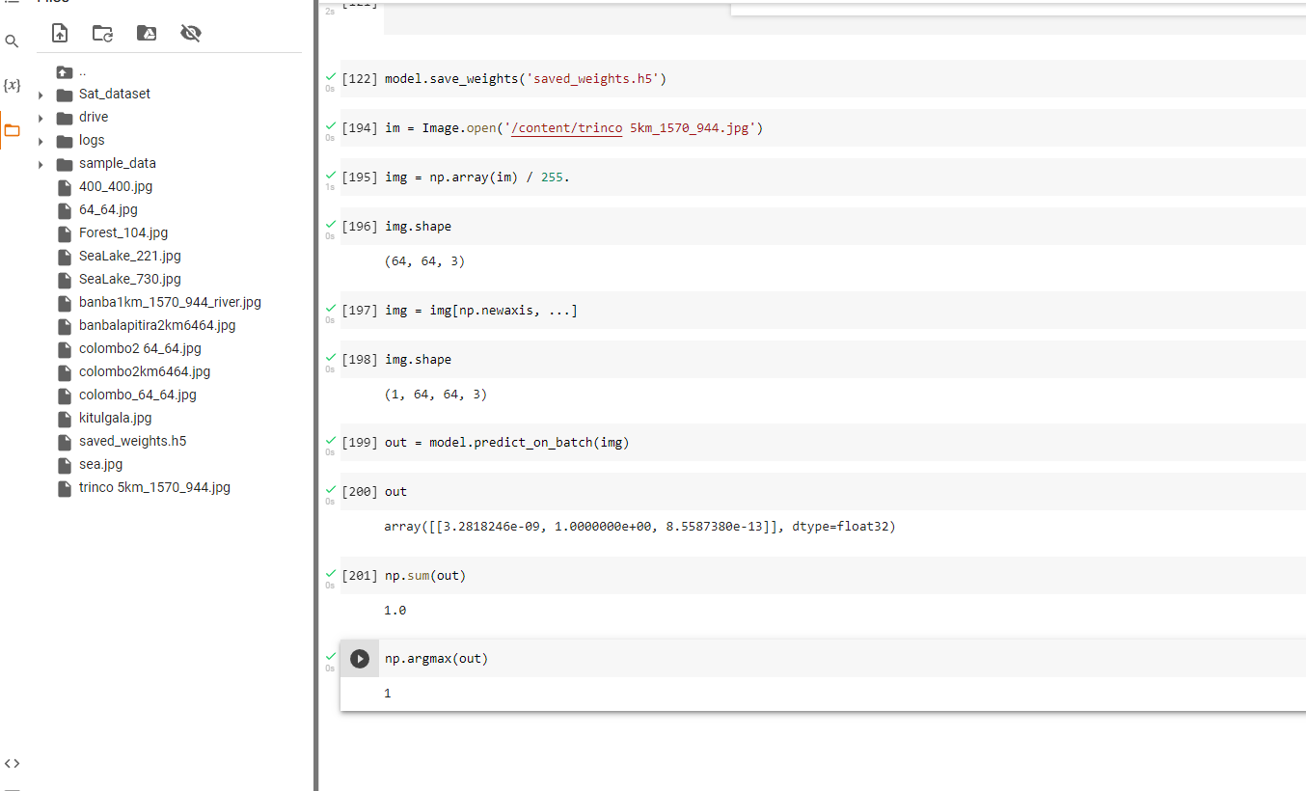

Vegitation
5km 1570*944
64*64

Slide 10
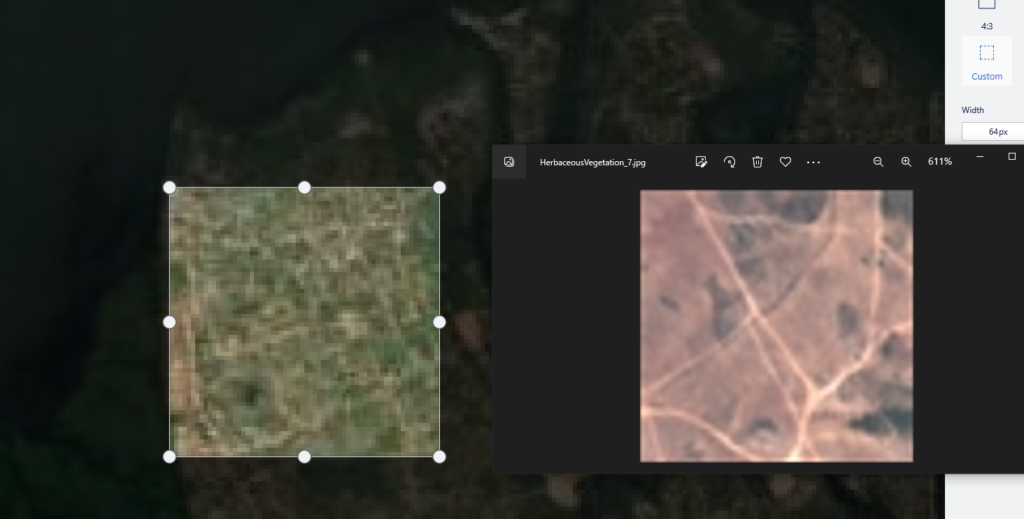
More develop image
Our last pic
Sample
Need to impove Pic resalution

